Slide 1
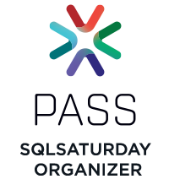
Intro to SQL Operations Studio
Eric Flamm
Flamm Consulting, Inc.
Azure Data
Notes:
On September 24, the SQL Operations Studio merged a large number of changes into the project to change the name to Azure Data Studio, and raised the Version level from 0.33.7 (released August 30) to General Availability.

Slide 2
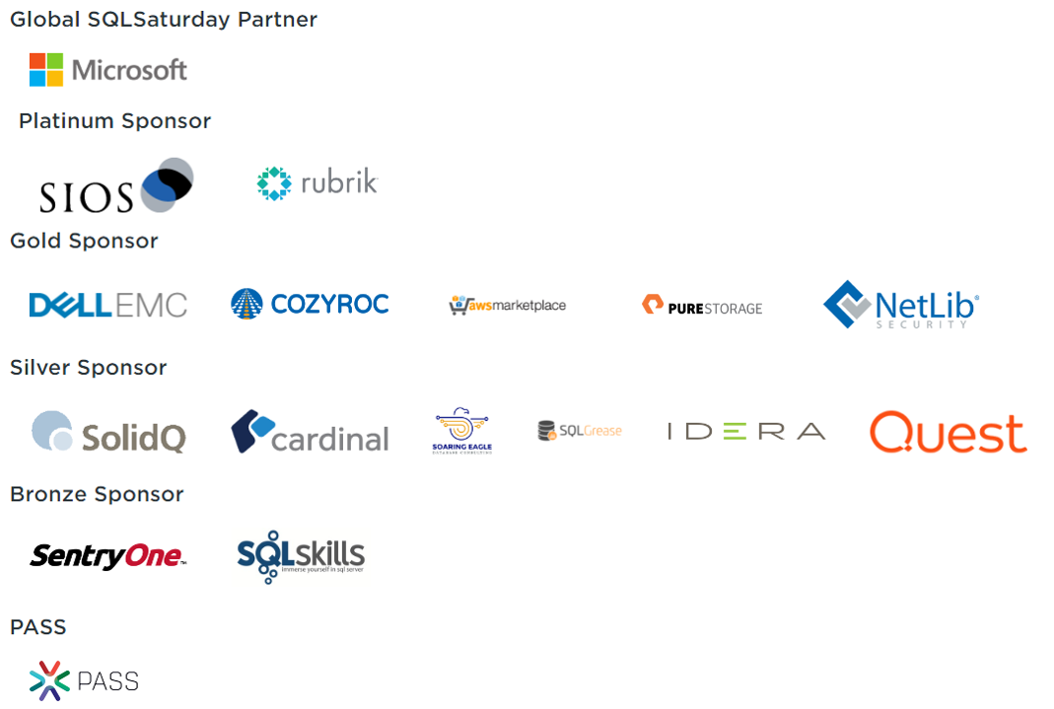
Thanks to our Sponsors!

Slide 3
Agenda
Intro
About Azure Data Studio
Demo
Resources
Q & A

Slide 4
About Me
Independent Business Intelligence/Analytics Consultant
MCP: Querying Microsoft SQL Server 2012
Presented at SQL Saturday Atlanta and Chicago, Code Camp, AWS Meetup, Azure DataFest 2018, WordCamp
Active Volunteer with Atlanta Microsoft Database Forum (local PASS Chapter)
Organizing Committee for Atlanta SQL Saturday since 2010
Contact Info:
E-mail: eric@flammconsulting.com
Mobile: (678) 524-4256
Twitter: @eflamm
Web: www.flammconsulting.com

Slide 5
Poll
Heard of Azure Data Studio?
Used Azure Data Studio?
Used Azure Data Studio on Mac?
Used Azure Data Studio on Linux?
Used Azure Data Studio in Production?

Slide 6
1.0.0 (9/24)
0.33 (9/4!)
Notes:
SQL Operations Studio was announced for Public Preview on November 15th 2017
August “Recovery” Build (after some issues in the August Public Preview) released 9/4/2018
And now for something completely different: Azure Data Studio – GA on 9/24/2018!

Slide 7
About Azure Data Studio
Home Page: https://docs.microsoft.com/en-us/sql/azure-data-studio/what-is
Built on Electron Shell using Python on Node.js
Spin-off from Visual Studio Code project (but with a more focused audience)
GA with new name at MS Ignite in September, 2018
Notes:
GA slipped from June to September, including feature development, debugging, and branding changes

Slide 8
Azure Data Studio – Key Features
Modern light-weight shell with theming, user settings, full screen support, integrated terminal and numerous other features
Cross-Platform DB management for Windows, macOS and Linux.
Connectivity to on-prem and cloud platforms (not just SQL Server?)
SQL Server Connection Management with Connection Dialog, Server Groups, Azure Integration and Registered Servers
Object Explorer supporting schema browsing and contextual command execution
T-SQL Query Editor with advanced coding features such as autosuggestions, error diagnostics, tooltips, formatting and peek definition
(more…)

Slide 9
Azure Data Studio – Key Features
Query Results Viewer with advanced data grid supporting large result sets, export to JSON\CSV\Excel, query plan and charting
Management Dashboard supporting customizable widgets with drill-through actionable insights
Visual Data Editor that enables direct row insertion, update and deletion into tables
Task History window to view current task execution status, completion results with error messages and task T-SQL scripting
Scripting support to generate CREATE, SELECT, ALTER and DROP statements for database objects
Workspaces with full Git integration and Find In Files support to managing T-SQL script libraries
Extensibility – inherited from VS Code, along with data management-specific elements

Slide 10
Azure Data Studio – Comparative
 | SSMS | Azure Data | VS 2017 | CLI/PowerShell
Licensing | Free | Free | $3K+/year | CLI-open source in preview; PowerShell -free
Runs on: | Windows | Windows, MacOS, Linux | Windows, macOS, Android | Mssql-cli: should run anywhere Python runs PowerShell runs everywhere
Ease of Use/ Learning Curve | Extensive Feature Set | Still emerging | Database functionality is small part of package | Text interfaces – challenging to go beyond sample scripts
Localization | 11 languages | Coming Soon | 11 languages | CLI-English only?; PowerShell – custom files

Slide 11
Azure Data Studio – Use Cases
Newly Released to GA – Version 1.0.0
T-SQL focused
Intellisense
Templates
Query Plan
Connection Management
SQL Server, Azure SQL, Azure Data Warehouse
Cross-Platform
Extensible-(ex: Profiler (EE) Extension)

Slide 12
How to Get Azure Data Studio
Windows – Download and run the installer from aka.ms/azuredatastudio (linked as Download page)
Linux – Depends on the distro – download the appropriate package, update the package store, and install with yum or apt‐get – instructions for popular distros are on the download page
Mac – download the Zip file, expand it and drag Azure Data Studio.app to the Applications folder
Notes:
cd ~
sudo yum install ./Downloads/azuredatastudio-linux1.0.0.rpm
azuredatastudio (starts the app)
Downloads USED to be stored in AWS! Now they’re stored in Azure Blob Storage

Slide 13
Azure Data Studio Roadmap
Documented as “Milestones” on Github
July “GA” Release – 7/18/2018
July Public Preview – 7/20 & 7/24
August “Recovery” Build – 9/4
GA (with new Branding) – 9/24
October Release – 10/17
November Release -11/15
December Release – 12/11
Notes:
Milestones comprise designated issues documented on Github. Presumably, some issues are already being deferred to releases subsequent to GA date.

Slide 14
Demos
Intro to UI
Create a SQL Server Connection Object
Start a “Profiler” session on the Profiler extension
Retrieve some data
Save results to JSON file
View data as chart
View Profiler Output
Redgate SQL Search extension
Whoisactive Extension
Notes:
Demos – Just use Windows on laptop to demo
1)

Slide 15
DEMOS
Notes:
Intro to UI
Sidebar (Ctrl-B): Servers-New,Group,Active; Task History; Explorer (Workspace-based); Search/Replace; Source Control; Extensions; Settings;
Menu Bar-File menu to manage workspaces/folders; view menu to manage desktop appearance; view menu toggles built-in terminal (Ctrl-J panel view) and command palette
Status Bar: Errors/Warnings/Updates Pending. Also Notifications, document type
Editor (canvas) – customizable layout grid
Create a SQL Server Connection Object – connect to local SQL Server – WideWorldImportersDW – add to Laptop Group
Open server dashboard – backup status, object browser
Start a “Profiler” session on the Profiler extension – alt-P
Retrieve some data (auto query; custom query for export/graph)
Point out Status Bar info (lower right corner)
Can demonstrate copying object from 1 db (in Azure) to another (on prem) – script as create, change connection, run
Save results to JSON file
New query – using top 10 with sort by quantity
View data as chart
Change data orientation to vertical
Check use column names as labels
Change y axis min to 0
View Profiler Output
LETS LOOK AT SETTINGS (JSON FILE!)
Redgate SQL Search extension
Whoisactive Extension

Slide 16
Azure Data Studio – Connection Settings
"datasource.connections": [
{
"options": {
"connectionName": "WWI on Azure",
"server": "uxjf04zebq.database.windows.net,1433",
"database": "WideWorldImporters-Standard",
"authenticationType": "SqlLogin",
"user": "eflamm@uxjf04zebq",
"password": "",
"connectTimeout": 30,
"applicationName": "sqlops",
"groupId": "4979792e-41ae-4017-960d-ecb36ce6e4b4",
"databaseDisplayName": "WideWorldImporters-Standard"
},
"groupId": "4979792e-41ae-4017-960d-ecb36ce6e4b4",
"providerName": "MSSQL",
"savePassword": true,
"id": "1a176a71-3446-47e9-af2a-40c28ace27bd"
}
]

Slide 17
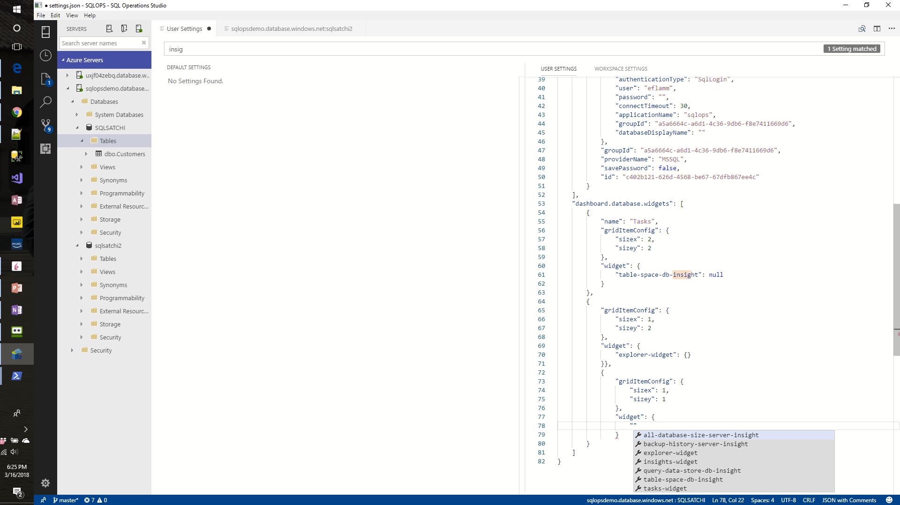
Azure Data Studio – Dashboard Settings
"name": "Tasks",
"gridItemConfig": {
"sizex": 2,
"sizey": 2},
"widget": {
"table-space-db-insight": null}
},
{
"gridItemConfig": {
"sizex": 1,
"sizey": 2},
"widget": {
"explorer-widget": {}
}

Slide 18
Resources
Github Repo: https://github.com/Microsoft/azuredatastudio
SQL Blog: https://cloudblogs.microsoft.com/sqlserver/2018/09/25/azure-data-studio-for-sql-server/
Official FAQ: https://docs.microsoft.com/en-us/sql/azure-data-studio/faq
Grant Fritchey’s blog post: https://www.scarydba.com/2018/09/24/introducing-azure-data-studio/
Keyboard Shortcuts (VS Code) – includes links to printable cheat sheets: https://code.visualstudio.com/docs/getstarted/keybindings

Slide 19
Q & A
Work in progress:
https://sqlopsbotoct18.azurewebsites.net/

